Slide 1

AIS Workshop 2
Building a cool NLP Application using Google BERT
BY
SNEHA NAIR
MAITREYEE MHASAKAR

Slide 2
Workshop overview
Dataset
Neural Networks
Word Embeddings
BERT
Building cool application with BERT

Slide 3
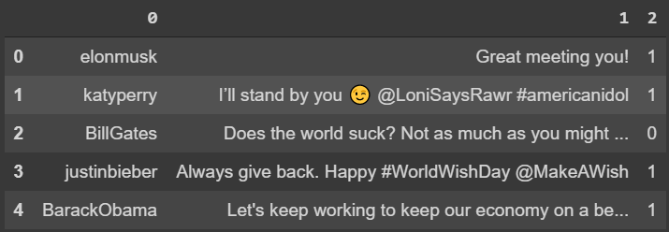
DATASET

Slide 4
Why do we need Text Embedding?
Conversion from text to numeric vectors
Ways to convert text into numeric vectors:
Convert characters to ASCII values
One hot encoding
Word2vec

Slide 5
Character to ASCII Value
cat:
c a t:
99 97 116
Cats:
C a t s:
67 97 116 115
car:
c a r:
99 97 114
Numeric Similarity but no semantic similarity

Slide 6
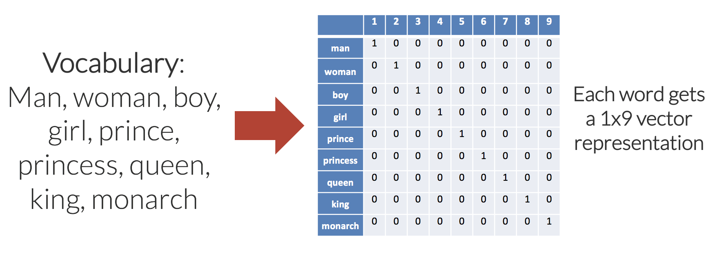
One Hot Encoding
Word representation as Vector of 1s and 0s

Slide 7
One Hot Encoding
Unique identification of words in a sentence
Still no semantic similarity

Slide 8
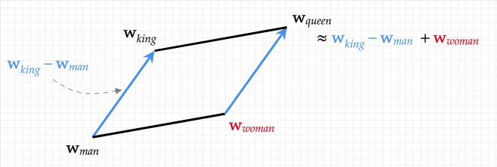
Word2vec
Mapping word into a numeric vector

Slide 9
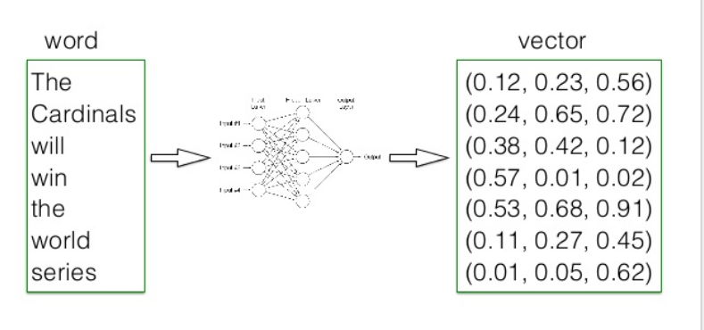
Word2vec

Slide 10
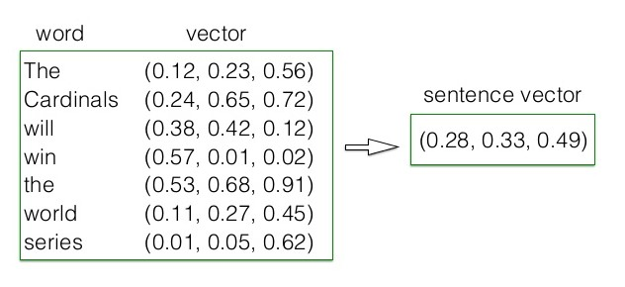
Word2vec

Slide 11
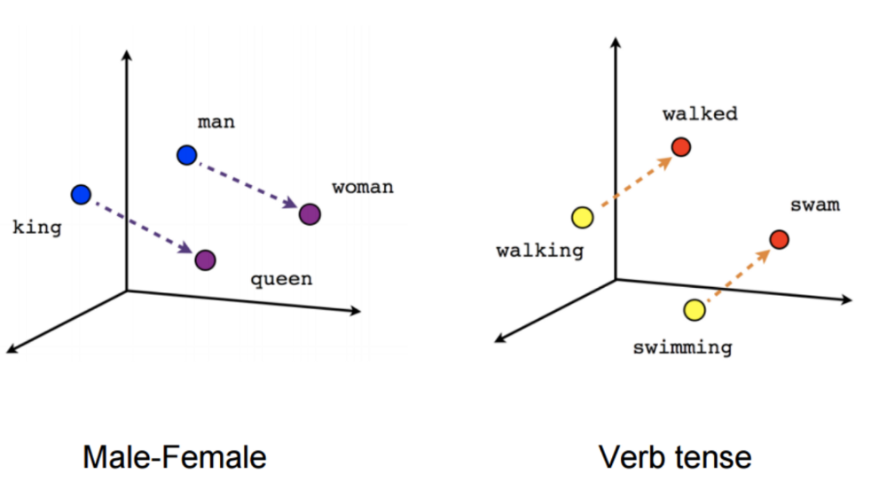
Word2vec
Better than One Hot Encoding
No Context differentiation

Slide 12
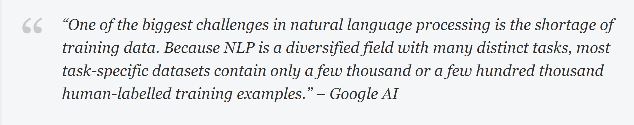
Why BERT ??
Functionality: Converts sentence or string of sentences to contextual and numeric representation
Then this representation fed as input to model
Disadvantage: Slow convergence and long training time.
Advantage: learns contextual representation in text far better

Slide 13
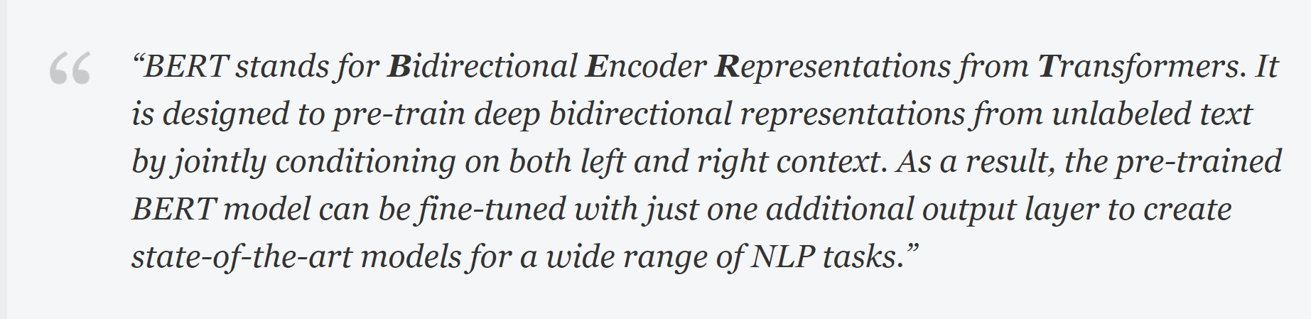
What is BERT ????????
Notes:
Define shallow concatenate if you use that term
What’s the point of bidirectional?
Attention layers are mentioned in further slides. Reassure audience that it is a concept we will go into in future slides. Fow now, give a basic, highly abstracted definition.

Slide 14
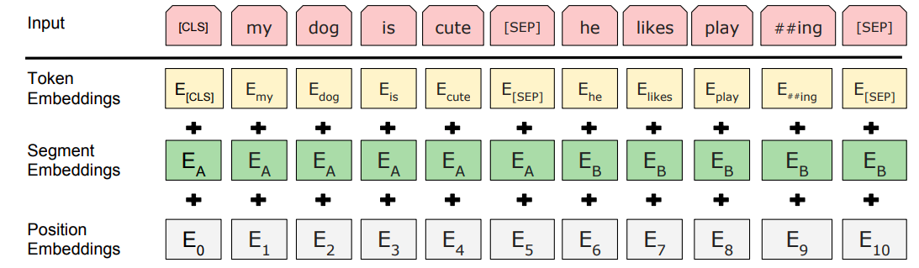
Input Representation

Slide 15
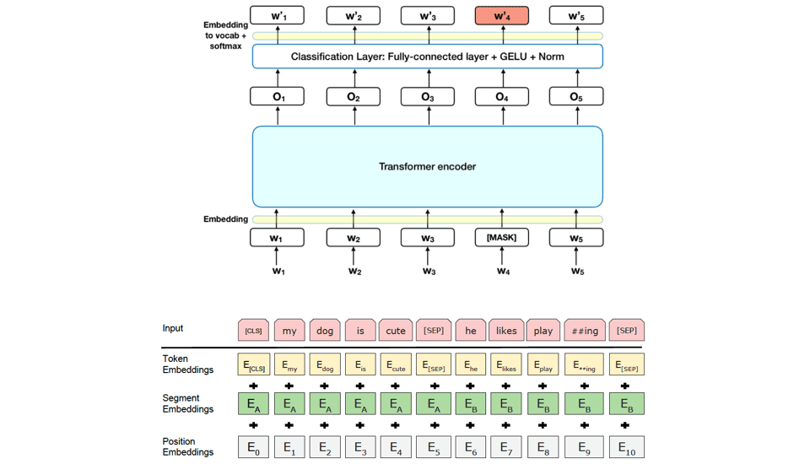

Slide 16
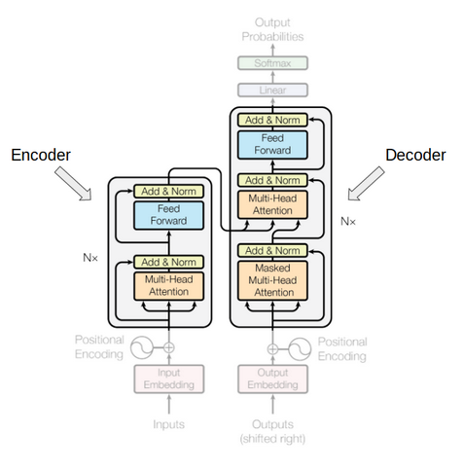
Transformers

Slide 17
ATTENTION
Attention head is composed of the four W matrices (Wk, Wq, Wv and Wo) that is learnt during training.
How it works in BERT ?
Each word is mapped to the Bert vocab.
Constructs vector for each word - a weighted sum of the vectors of all the words in the sentence
Contribution of each word vector - attention head matrices, its position and closeness of two word vectors
Each layer of BERT model has multiple attention heads
Attention Head outputs -> a non-linear feed forward layer -> next Encoder layer

Slide 18
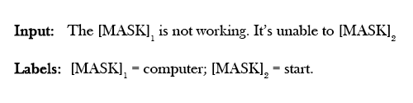
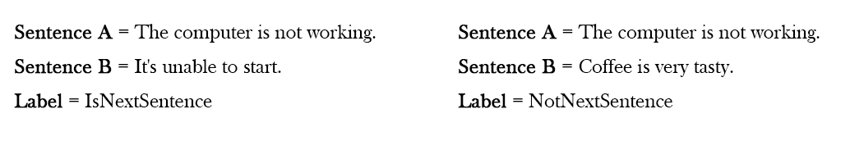
How is BERT pre-trained ?
Mask Language Model (MLM)
Next Sentence Prediction (NSP)

Slide 19
Model Training
Pre-training phase
Fine-tuning phase: Fine-tune this large model to specific NLP tasks to utilize the large repository of knowledge this model has gained (supervised)
Only some model hyperparameters are changed such as batch size, learning rate and number of training epochs

Slide 20
How is it different from others ?
LSTM models used in ELMo (Embeddings from Language Model) are trained on left-to-right and right-to-left contexts and shallowly concatenating them
This means the representation cannot take advantage of both left and right contexts simultaneously.
BERT has inspired many recent NLP architectures, training approaches and language models, such as Google’s TransformerXL, OpenAI’s GPT-2, XLNet, ERNIE2.0, RoBERTa

